Slide 1
Bfs AND DFS:
Graph traversal

Slide 2
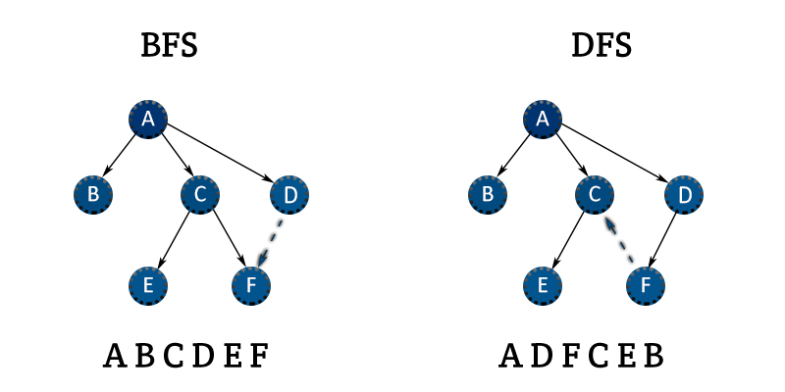
Agenda
What is BFS?
BFS idea with a small graph.
What is DFS?
DFS idea with a small graph
BFS vs DFS comparison.

Slide 3
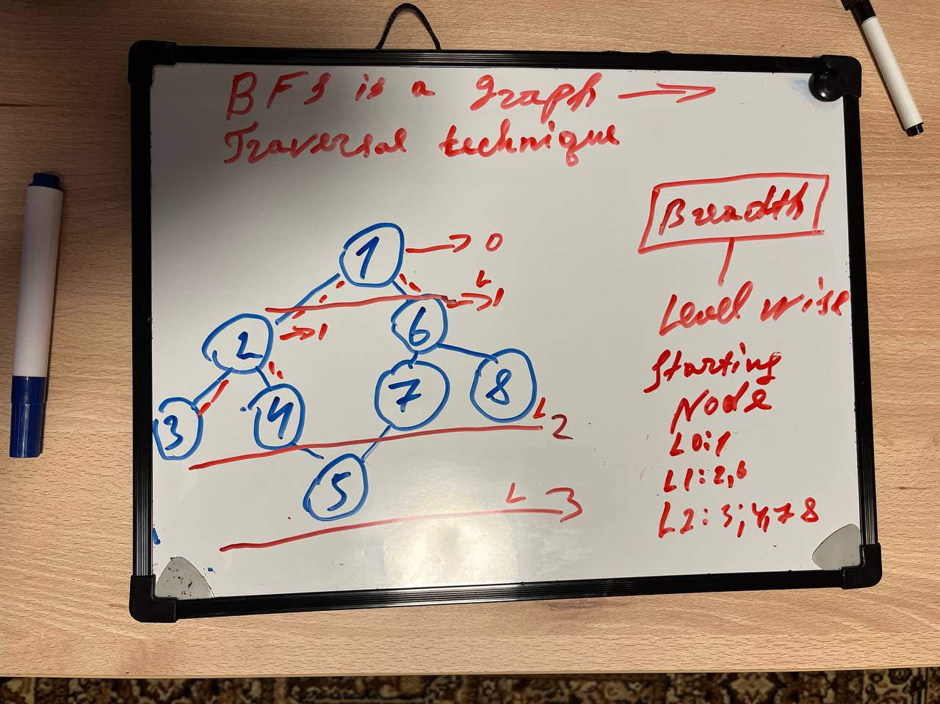

What is
BFS

Slide 4
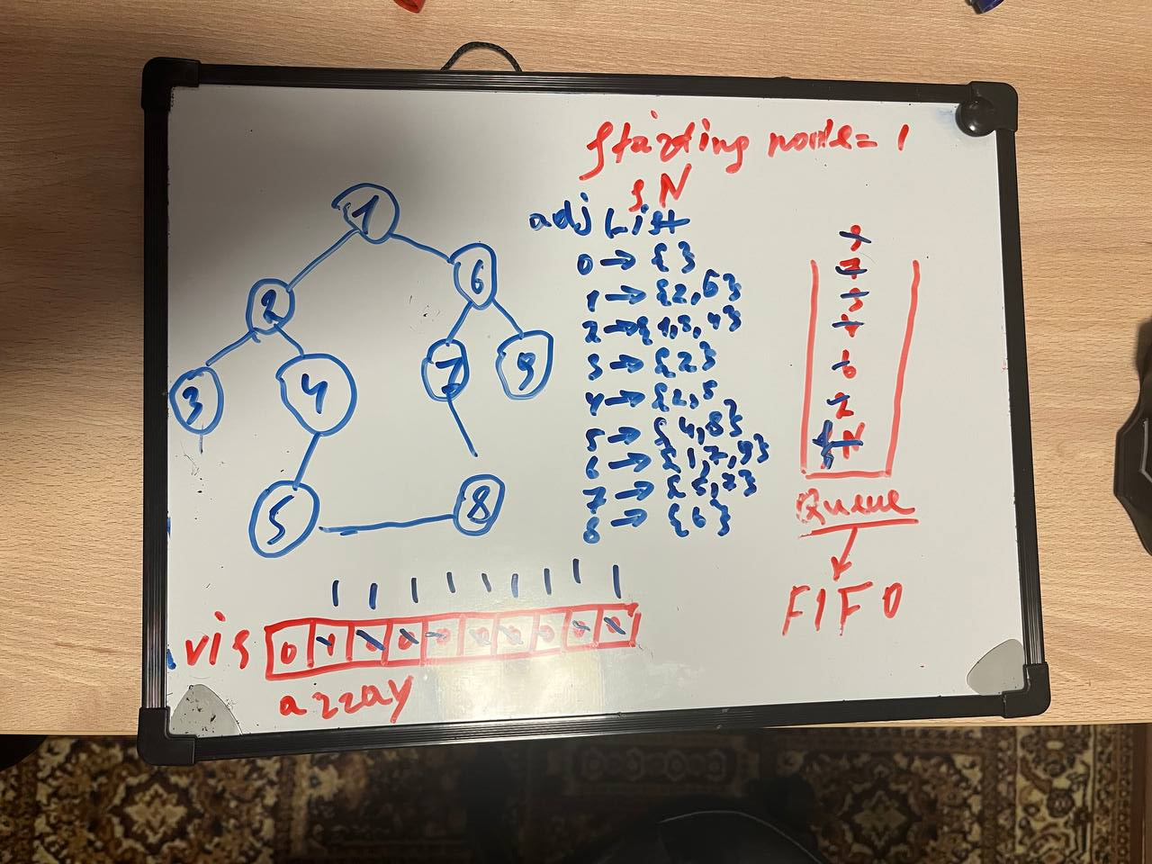
What is
BFS

Slide 5
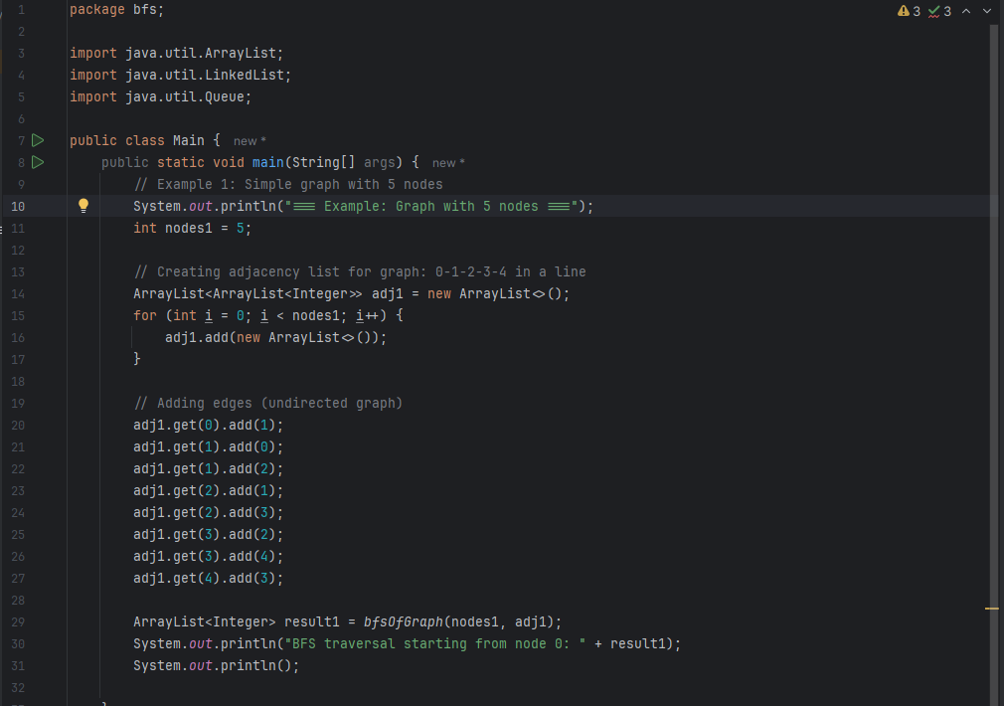
Bfs in code 1

Slide 6
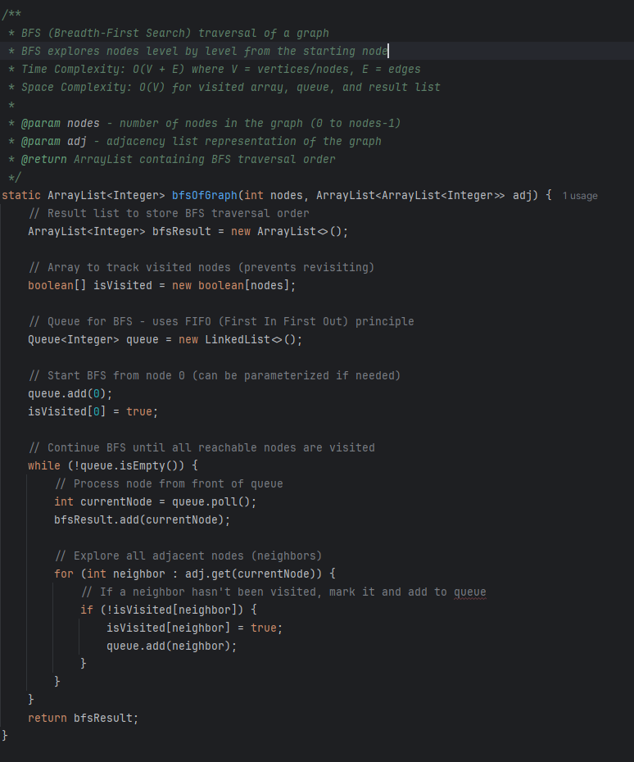
Bfs in code 2

Slide 7
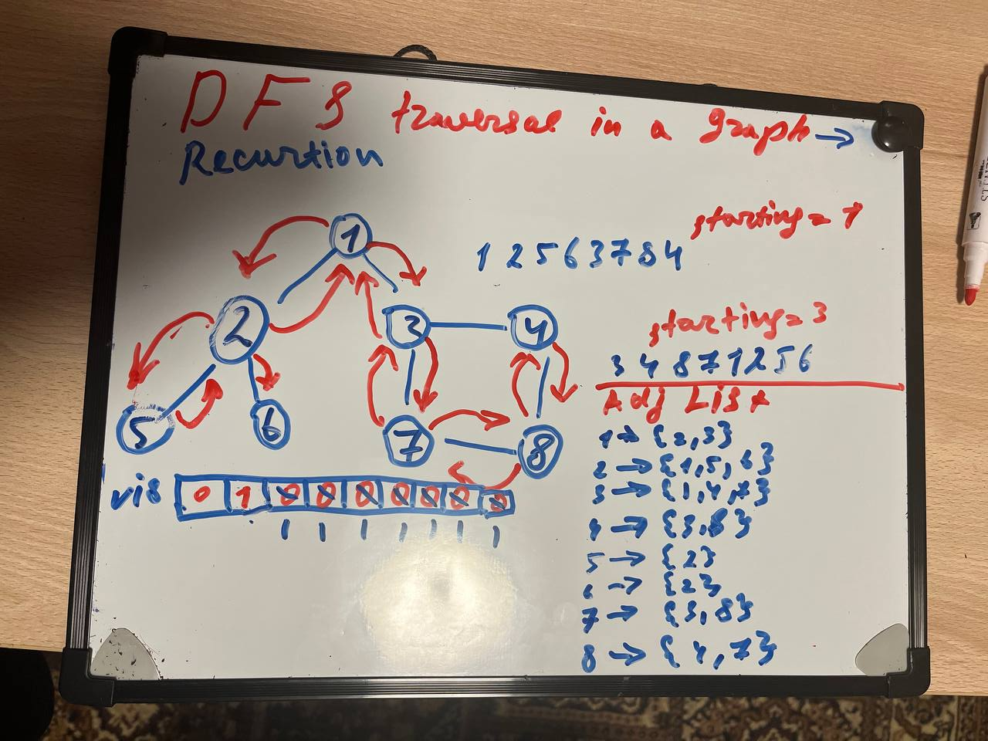
What is
DFS

Slide 8
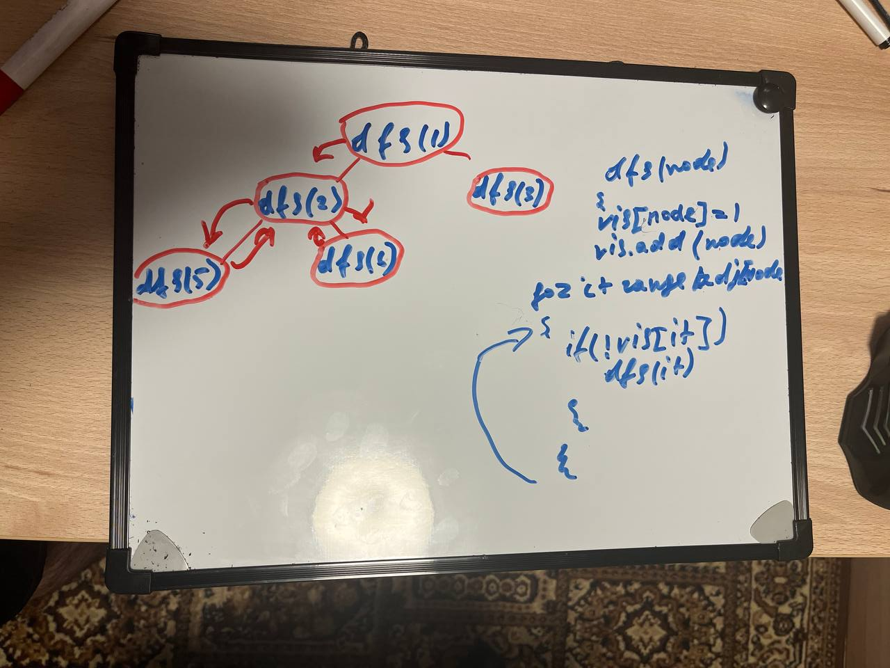
What is
DFS

Slide 9
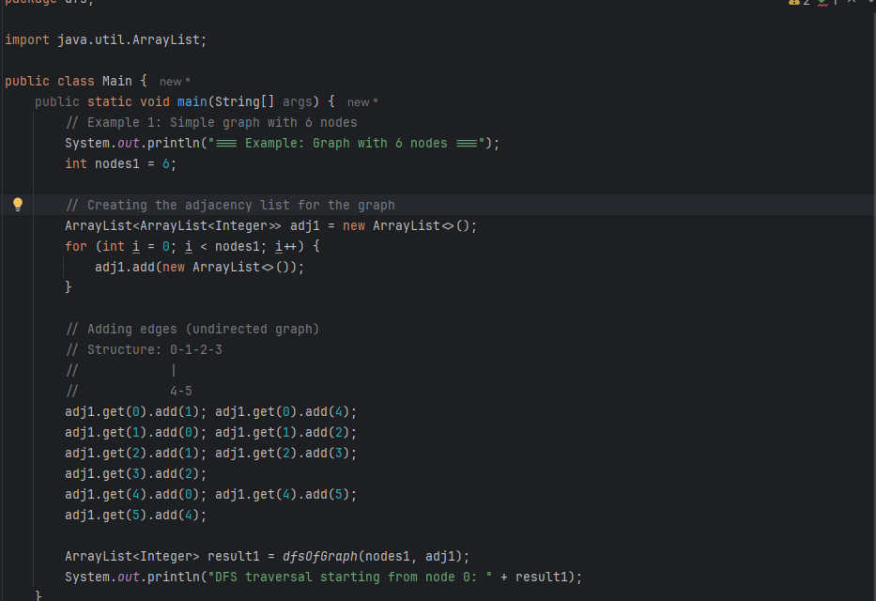
DFS in code 1

Slide 10
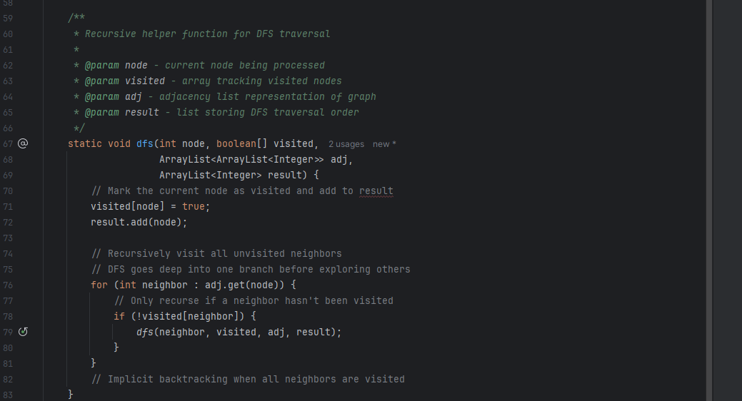
DFS in code 2

Slide 11
THANK YOU
Adkham Salaydinov
Algorithms I

